Slide 1
Hardware Repairs

Slide 2

RROD/YLOD/Black Screen

Slide 3
Ball Grid Arrays

Slide 4
BGA Reballing

Slide 5
BGA Reflow

Slide 6
Bad Solder Joints

Slide 7
Cracked Traces

Slide 8
Bad Capacitors

Slide 9
Burned Components

Slide 10
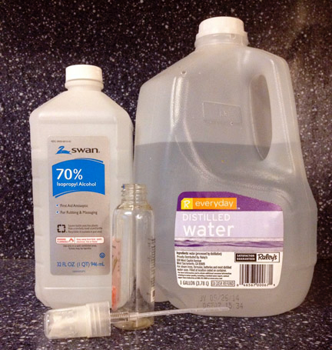
Water Damage

